Slide 1

DEPARTMENT OF COMPUTER SCIENCE AND ENGINEERING
Mini Project Review
On
COLLEGE ENQUIRY CHATBOT
Team:-
T. Meenakshi(22UP5A0515)
A. Shruthika(21UP1A05D1)
T. Ajitha(22UP5A0516)
Under the guidance of :-
Mrs. G. Anitha
Asst. Prof

Slide 2
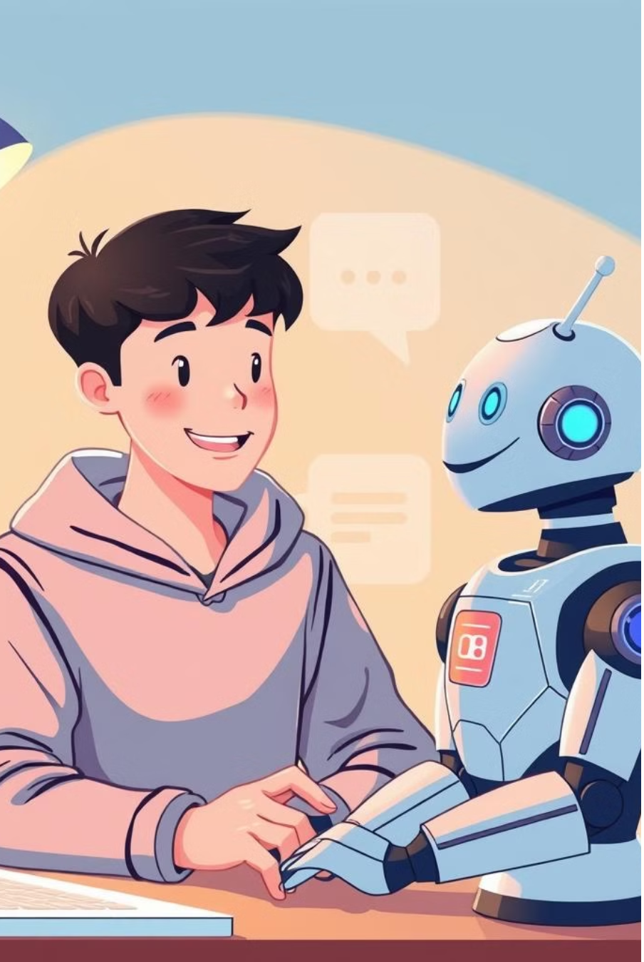
COLLEGE ENQUIRY CHATBOT

Slide 3
ABSTRACT
College enquiry Chat bot is simple web application which aims to provide the information regarding college. AI and web-based interactive College Enquiry Chat- bot is a straightforward web application that aims to supply knowledge regarding college The Chatbot created here may be a web-based application that uses tongue Processing Libraries and AI terminology to possess conversations with humans A state-of-the-art college inquiry chatbot powered by advanced Natural Language Processing (NLP) and machine learning Designed to provide instant, accurate, and personalized responses 24/7.

Slide 4
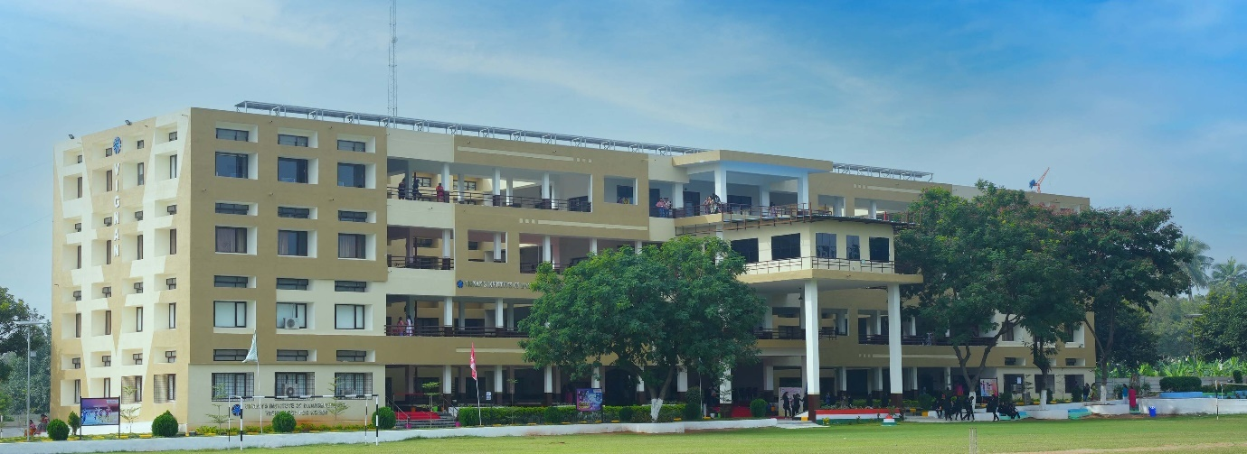
INTRODUCTION
College enquiry Chatbot uses machine learning concepts to have conversations with humans.
The purpose of developing this project is based on an intellectual chat-bot system which will deal with the academic activities like admission enquiry , fee structure , course allocation , scholarship details.

Slide 5

EXISTING SYSTEM
Need to manually visit college for any query.
More time consuming as well as money.
Delay in response.
Collecting the course details, fee structure manually will be a big procedure and it also needs manpower.

Slide 6
LIMITATIONS OF EXISTING SYSTEM
Time-Consuming
Limited Reach
Resource-Intensive
Lack of Real-Time Information
Limited Access
Inefficiency

Slide 7

PROPOSED SYSTEM
This is a Web Application Project entitled College Enquiry Chatbot.
This project will be developed using NLP Programming Language.
Chatbot responds to the user by greeting him/her and then asks user to login into the system by providing his/her mail.
Then the user finds the buttons in the UI which corresponds to the different categories of the college. After going through the buttons the chatbot system asks the user, is it helpful in giving the response.
If the user is not able to find the required response, he/she can continue the chat with the college chatbot system by briefly elaborating their queries.

Slide 8
ADVANTAGESOF PROPOSED SYSTEM
Quick and Efficient Information Retrieval
Cost-Effective
Consistent and Accurate Information
User-Friendly Experience
Data Collection and Insights
Integration with Other Systems
24/7 Availability

Slide 9
SYSTEM REQUIREMENT
Software Requirements:-
:
Front End
1.Visual studio code
2.CSS
3.Javascript
Back End
1.Python
Framework
1. Flask
Database
1.My SQL Database

Slide 10

SOFTWARE AND HARDWARE REQUIREMENT
Hardware Requirements:-
:
HARDDISK :250 GB
RAM:8GB
Processor: Intel Core i5 or any relevant

Slide 11
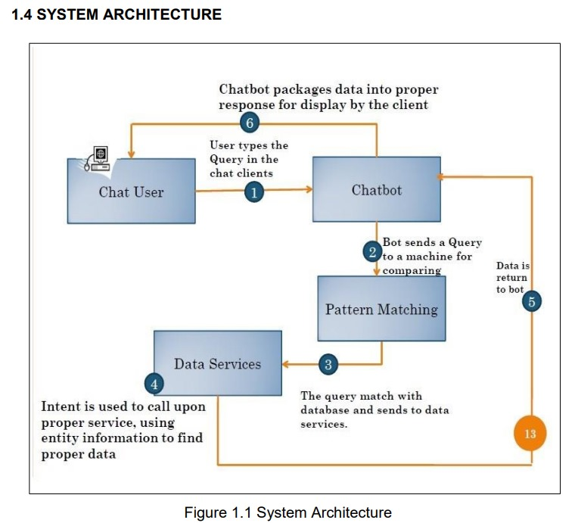
SYSTEM ARCHITECTURE

Slide 12
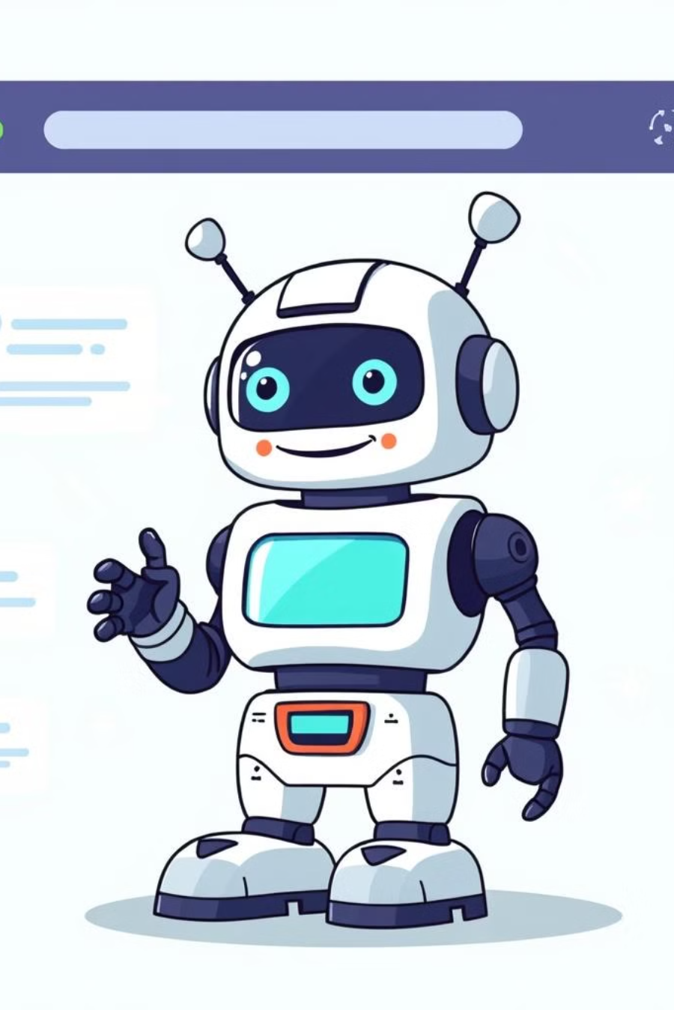
METHODOLOgY OVERVIEW
Collaborate with college departments to compile accurate and comprehensive information about academic programs, admission criteria, campus facilities, and other relevant details.
Implement NLP techniques to enable the chatbot to understand and respond to user queries In a conversational manner. Train the chatbot using relevant data to improve language comprehension.
Create an intuitive and visually appealing user interface for the chatbot. Design an interactive conversation flow that guides users through the enquiry process smoothly.
Develop the backend logic to process user queries, retrieve information from the database, and generate accurate responses. Integrate machine learning algorithms for continuous learning and improvement.

Slide 13
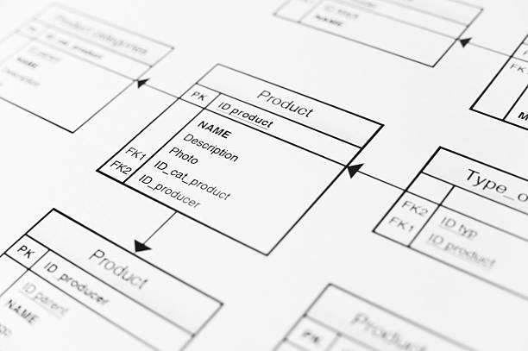
LIST OF UML DIAGRAMS
1
USE CASE
2
STATE CHART
3
CLASS
4
ACTIVITY

Slide 14
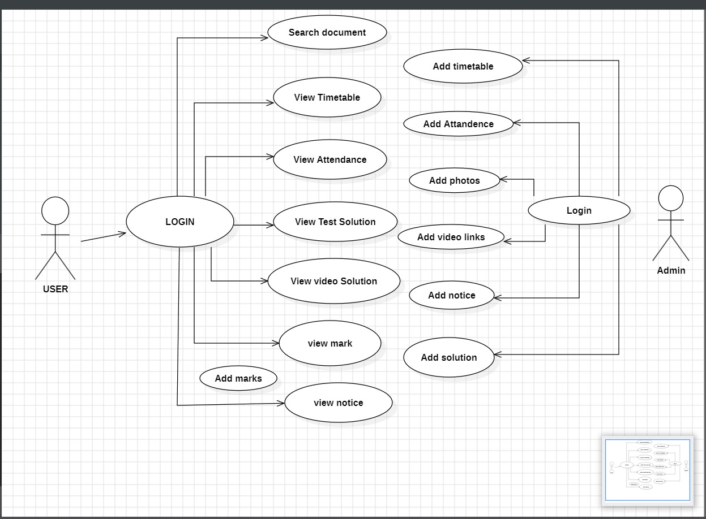
USE CASE DIAGRAM

Slide 15
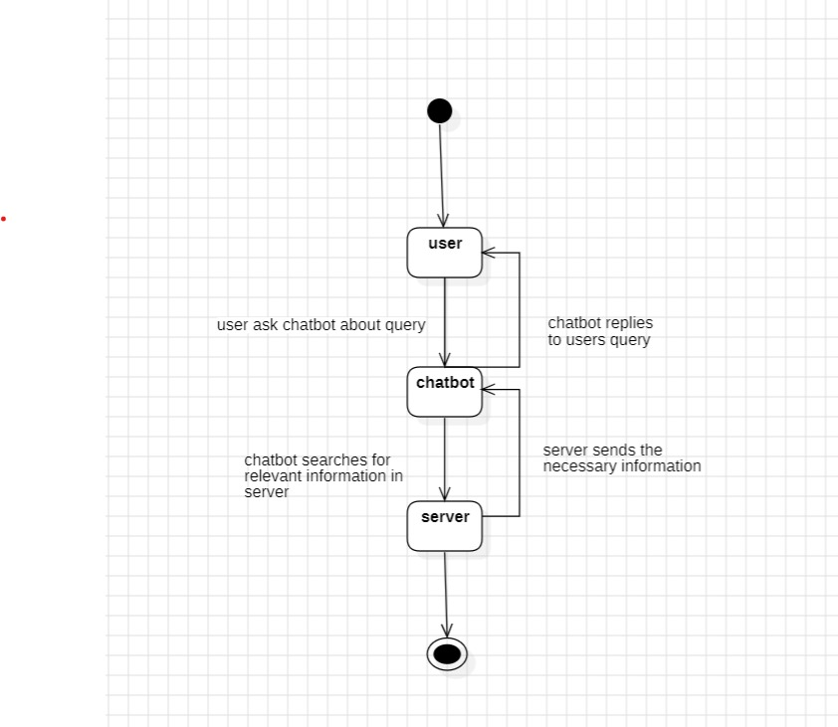
STATE CHART DIAGRAM

Slide 16
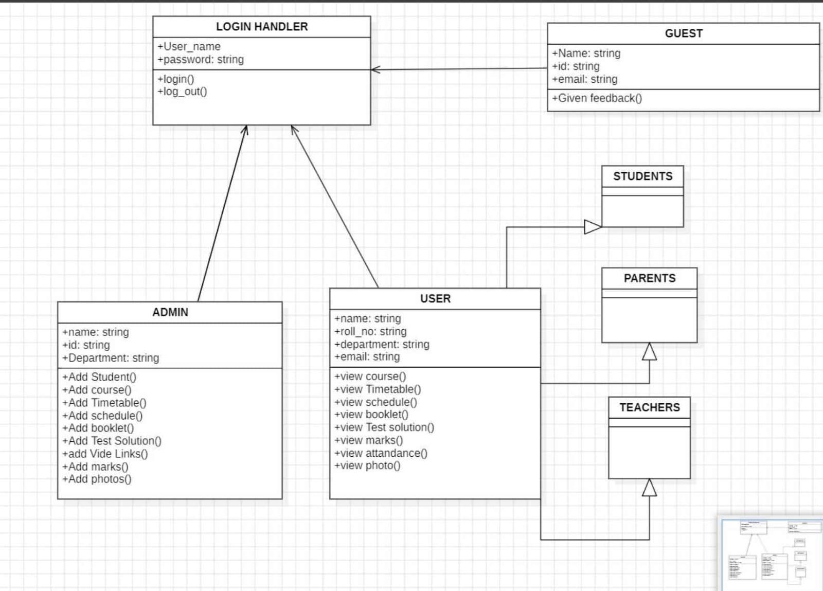
CLASS DIAGRAM

Slide 17
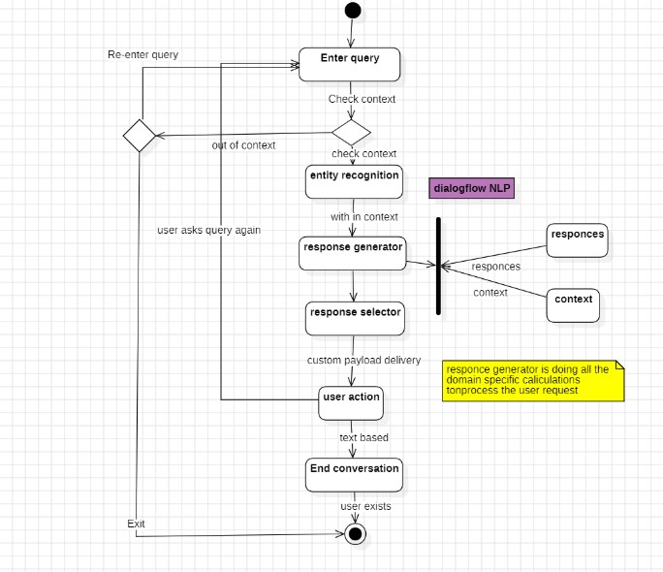
ACTIVITY DIAGRAM

Slide 18
IMPLEMENTATION
1. Flask App Backend
Routes:
(GET): Displays the homepage.
admin_chat (GET/POST): Handles the admin chatbot interface.
GET: Displays the admin chat interface.
POST: Processes user commands like adding/viewing faculty or timetable.
chatbot (GET/POST): Handles user chatbot interaction
POST: Processes user queries via process_user_query.
Functions:
execute query: Executes database write operations.
fetch_query: Fetches data from the database.
process_user_query: Handles user-specific chatbot responses.
Command Processing:
Commands like Add Faculty, Add Timetable, View Faculty, and View Timetable are supported.
Provides error handling and validation for inputs.

Slide 19
2. Admin Chatbot Frontend
HTML & CSS:
A clean interface with separate styles for user and bot messages.
Modals for adding faculty and timetable details.
JavaScript:
sendMessage: Handles the user input, sends it to the backend, and displays the bot's response.
submitFacultyForm & submitTimetableForm: Collect modal inputs, format them as commands, and send them to the backend.
Dynamic message display in the chatbox.
3. User Chatbot Frontend
Similar to the admin chatbot but styled differently for user interactions.
4. Additional Features
Database Operations:
Separate commands for viewing or adding faculty/timetable records.
Responds with meaningful errors or prompts for missing details.
Styling:
Different themes for admin and user interfaces.
Responsive chatboxes and modals.

Slide 20
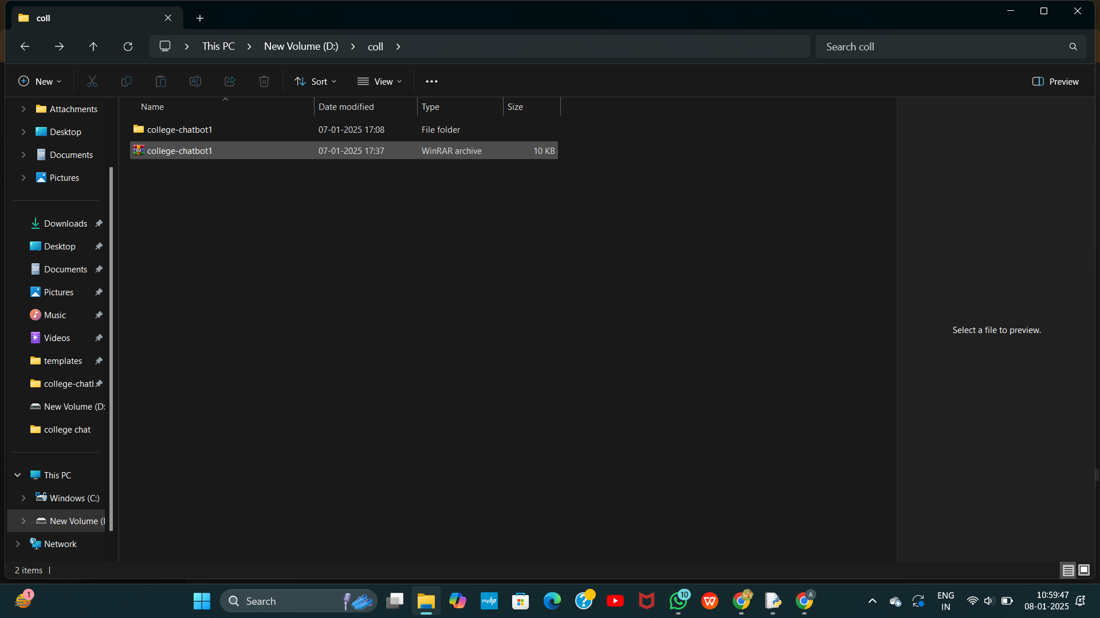

Slide 21
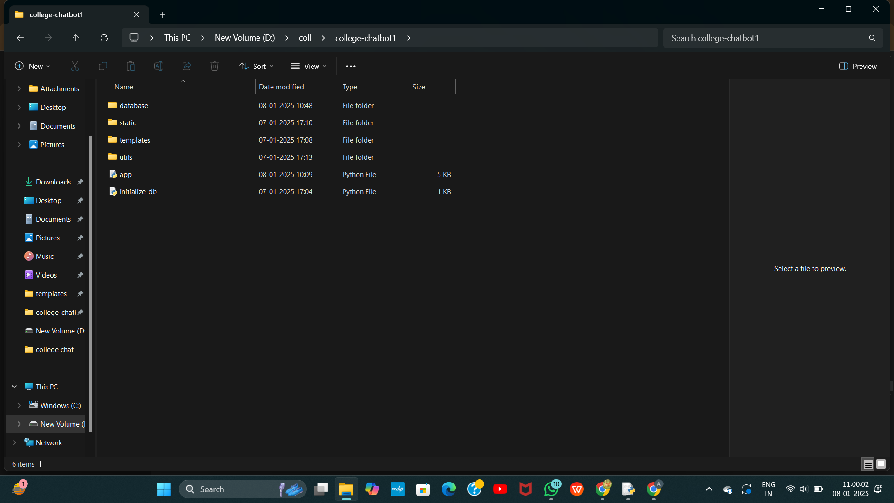

Slide 22
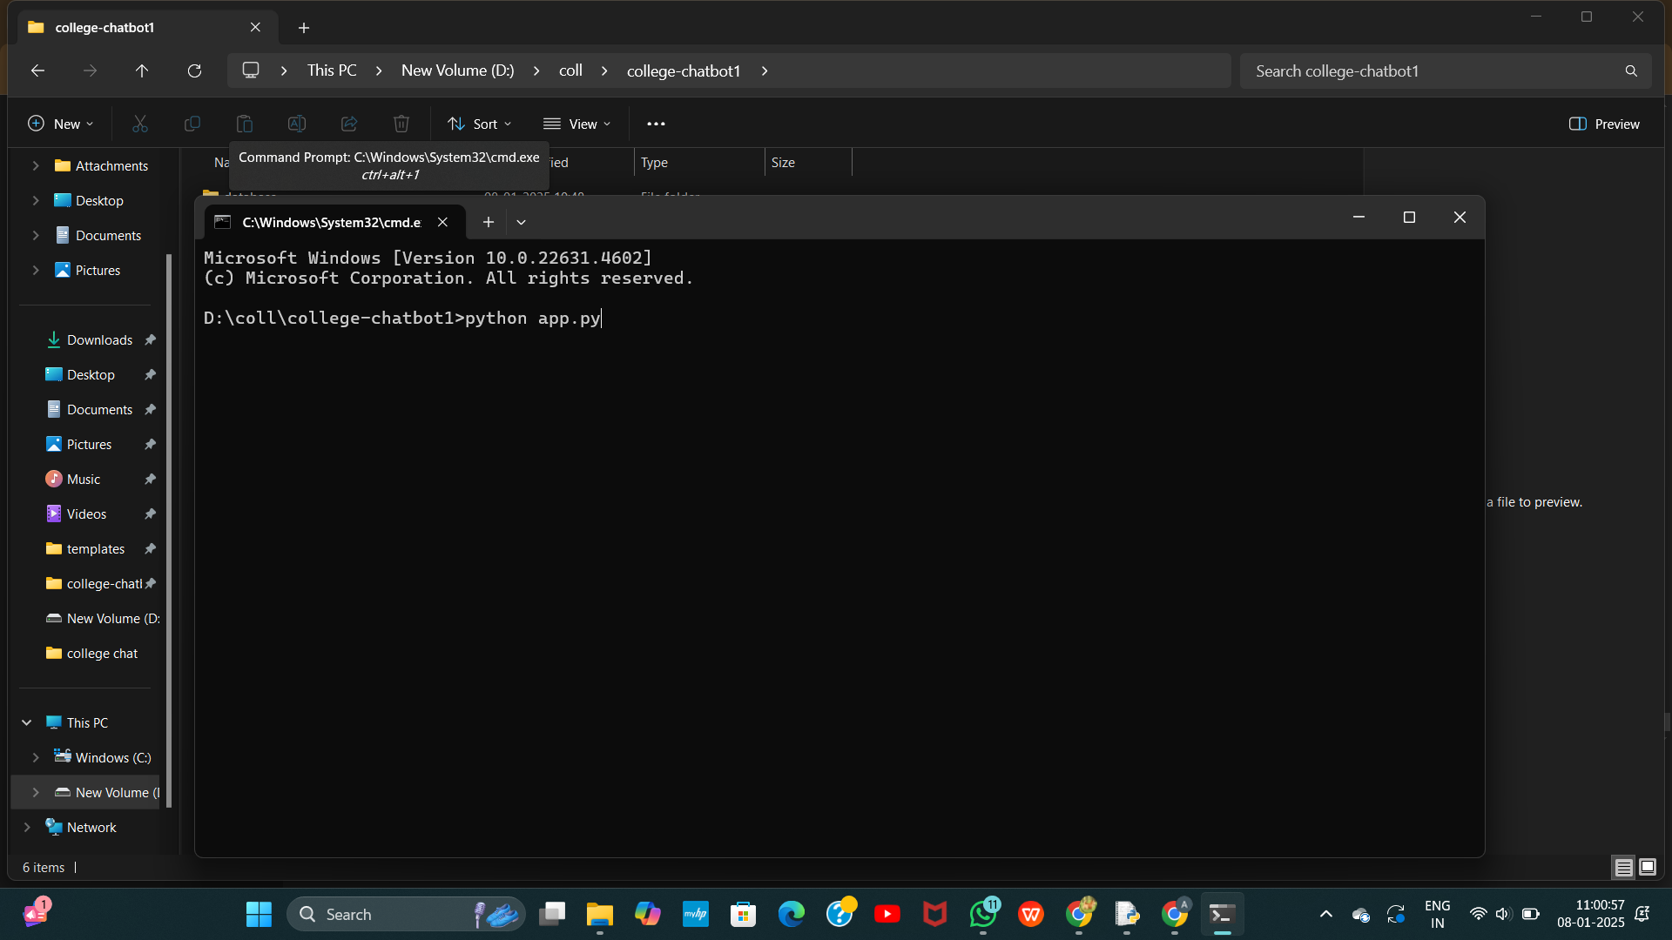

Slide 23
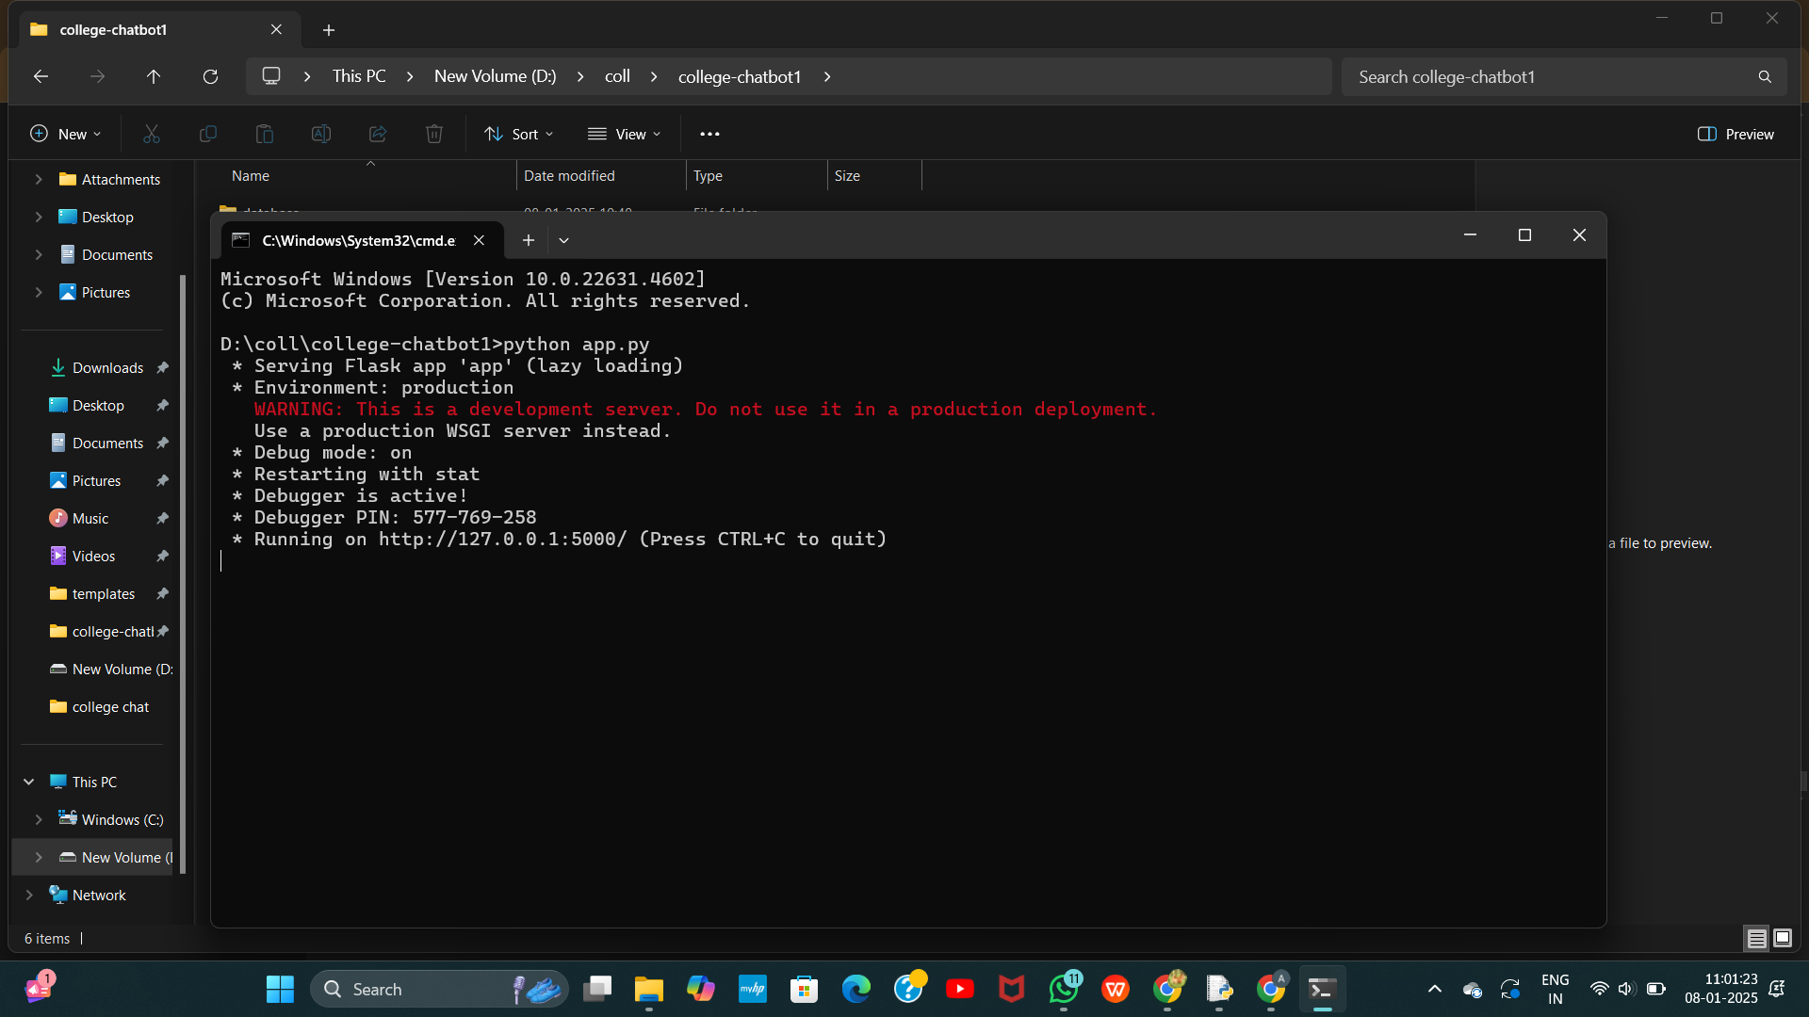

Slide 24
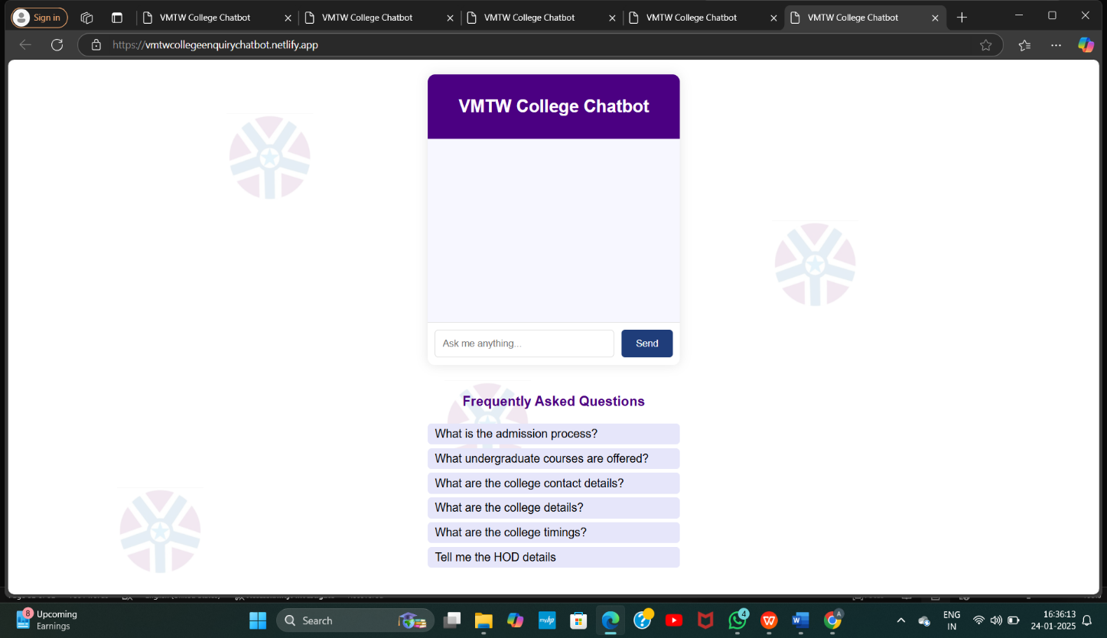

Slide 25
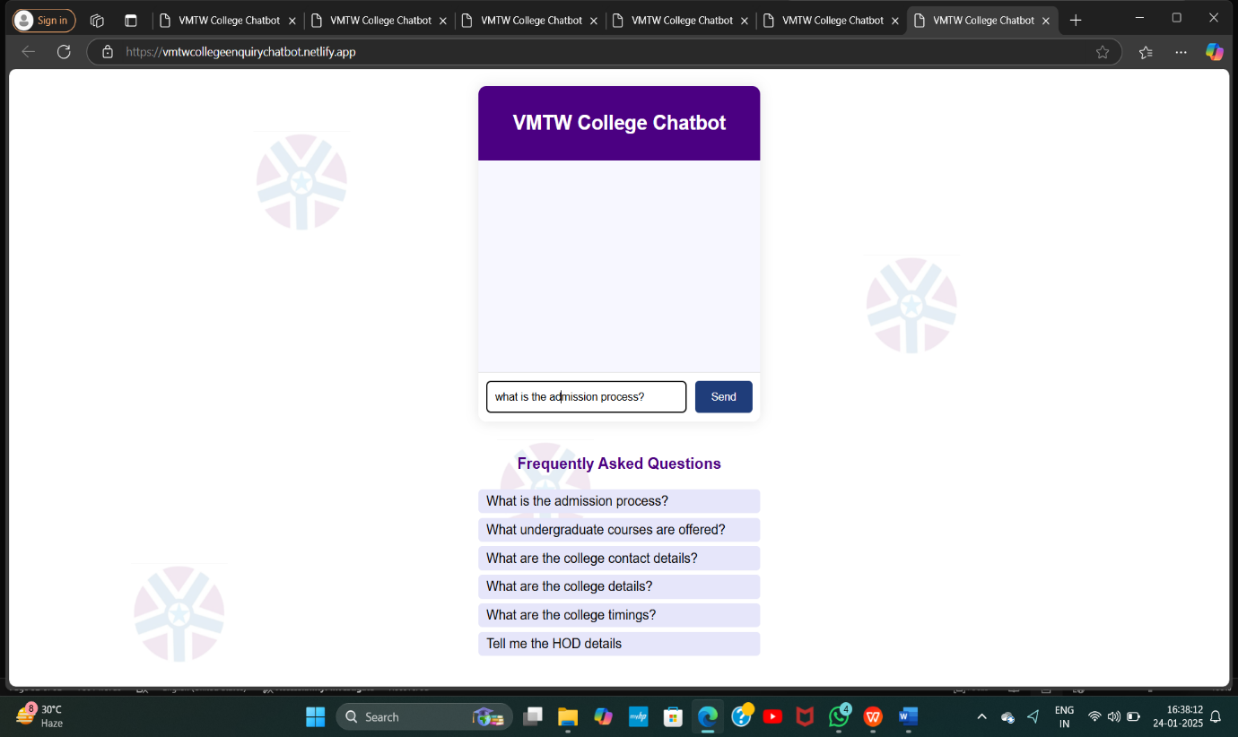

Slide 26
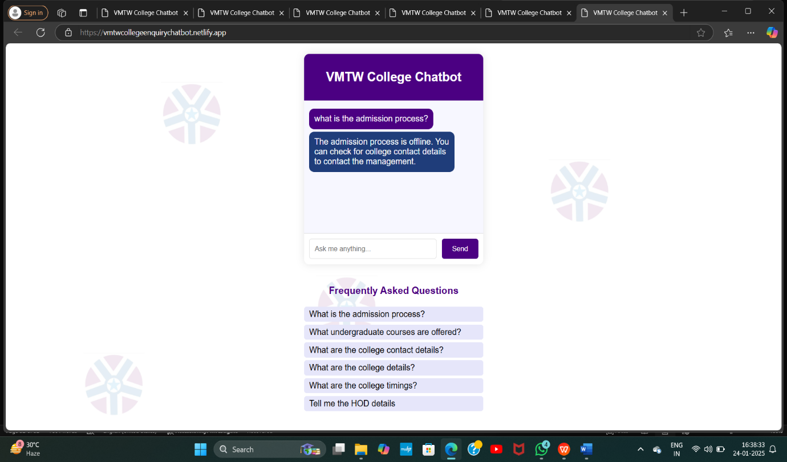

Slide 27
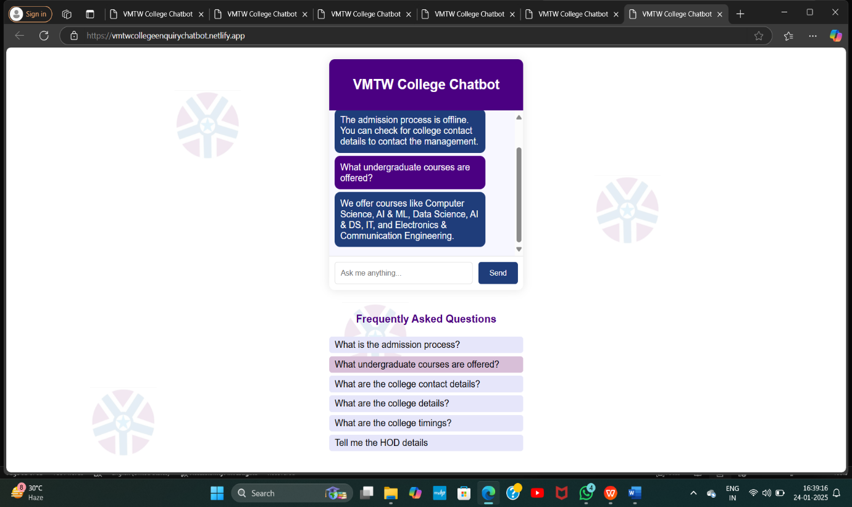

Slide 28
RESULT
The college inquiry chatbot successfully provides quick and accurate responses to user queries about the faculty and timetable. It can answer questions about Details of Faculty and Timetable. By using natural language processing, the chatbot understands user input effectively and provides relevant answers. It's easier for students and parents to get the information they need without delays. Overall, the chatbot enhances the college's support system by being available 24/7 and reducing the workload of staff.
Users can interact with the chatbot on
Proper functioning depends on
1.Correct setup of the database .
2.Accurate implementation of helper functions
3.Correct linking of static and template assets.
The admin can manage faculty and timetable records via chat commands on admin_chat.

Slide 29
CONCLUSION
The college enquiry chatbot is a valuable tool for enhancing communication and providing timely support to students and parents. It streamlines the process of answering frequently asked questions, reducing the workload of administrative staff while improving user satisfaction. By leveraging natural language processing and intuitive design, the chatbot ensures that users can access accurate information anytime, anywhere. This innovative solution not only saves time but also strengthens the institution's commitment to accessibility and student support, making it a vital asset for modern educational environments.

Slide 30
FUTURE SCOPE
The future scope of the code includes:
AI-Enhanced Chatbot: Implementing NLP for natural conversation, context awareness, and multilingual capabilities.
Dynamic Role Management: Expanding features tailored for students, faculty, and admins.
Automation & Integration: Automating routine tasks and integrating with learning management systems (LMS), academic calendars, and APIs.
User-Centric Features: Enhancing user experience with mobile-friendly designs and personalized notifications.
Analytics & Feedback: Providing insights on timetable usage, optimizing scheduling, and collecting user feedback.
Scalability & Security: Ensuring the app can support larger institutions while maintaining data privacy and compliance with regulations.

Slide 31
Thank You :)

